Slide 1

FOSTERING ACADEMIC EXCELLENCE
THROUGH UNIVERSITY STUDENT FEEDBACK
ENHANCING THE QUALITY OF SUBJECTS OF K20
IN FACULTY OF INFORMATION SYSTEMS

Slide 2

TABLE OF CONTENTS
1
Introduction
2
Theoretical background & Related Works
3
Windows Forms Interface Design
4
Database Design & Applying Machine Learning
5
Conclusion

Slide 3

INTRODUCTION
Our project, rooted in the K20 Faculty of Information Systems, harnesses student feedback to improve course quality. Using Aspect-Based Sentiment Analysis via ML.NET, we extract insights from evaluations to enhance the educational experience

Slide 4

THEORETICAL BACKGROUND
&
RELATED WORKS

Slide 5

RELATED WORKS
DEFINITION
Sentiment Analysis and Text Mining
Sentiment Analysis
Machine Learning in Education Feedback Analysis
Text Mining

Slide 6
RELATED TOOLS
Visual Studio 2022
C# and Window Forms
Microsoft SQL Server Management Studio
LINQ to SQL
SQL
ML.NET

Slide 7
WINDOWS FORMS
INTERFACE DESIGN

Slide 8

1. frmHome
This form provides windows for students to submit feedback and for lecturers to review and assess courses with
"Lecturers Only" button
"Send Feedback" button

Slide 9
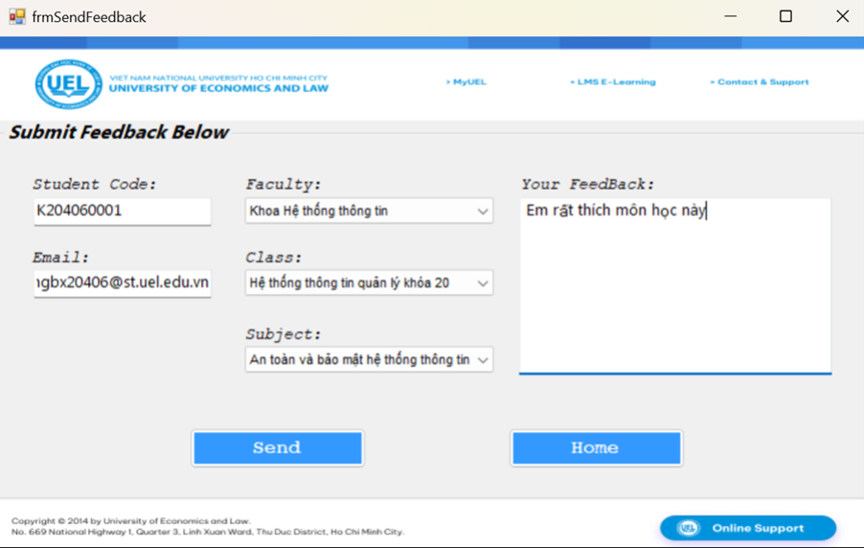
2. frmSendFeedback
This form let users to enter details, choose their class and subject, and submit feedback to the database.
Textboxes "Student Code" and "Email"
Combobox "Faculty"
Combobox "Class"
Combobox "Subject"

Slide 10
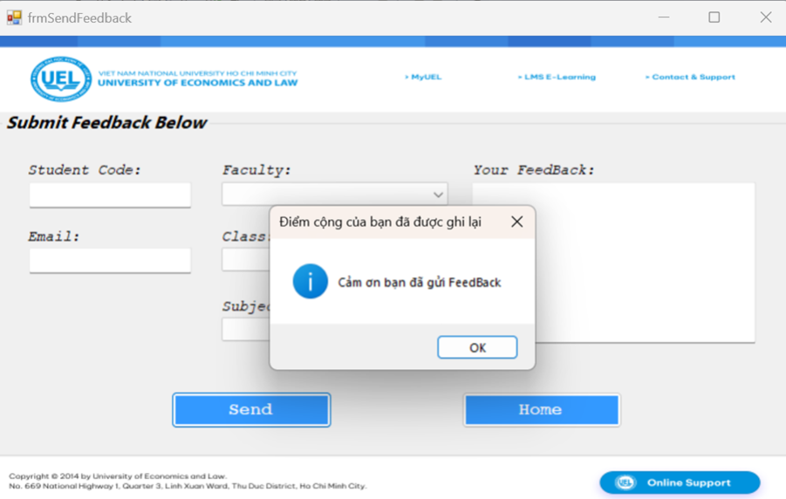
2. frmSendFeedback
Button "Send":
Initiates upon clicking "Send."
Verifies student info (code, email) in the database.
Checks alignment of Faculty, Class, and Subject.
Appends data to the "Feedback" table in the database.
Resets input in ComboBoxes and textboxes.
Displays success message.

Slide 11
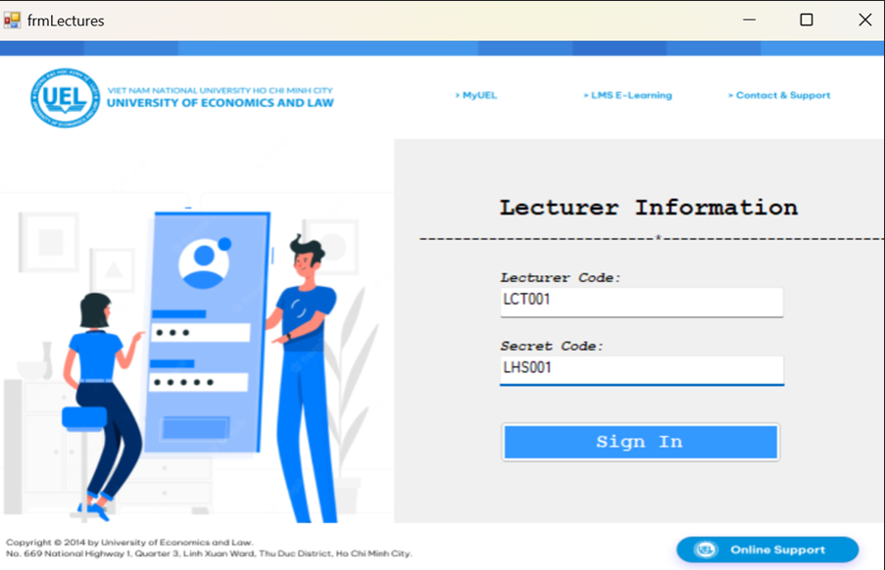
3. frmLecturers
Button Sign In:
Input Lecturer Code and Secret Code and compare provided data with "Lecturers" table.
If correct, opens "frmShowFeedback" form for feedback display.
If incorrect, increments "loginAttempts."
Exceeding 3 attempts closes "frmLectures," shows "frmHome."

Slide 12
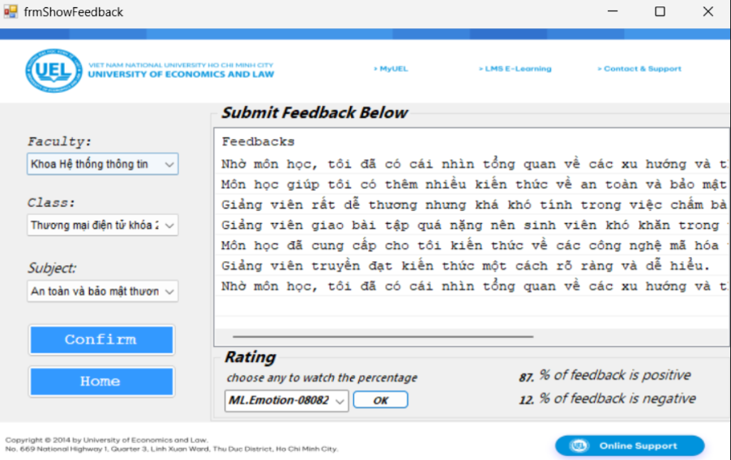
4. frmShowFeedback
This form provides users with the ability to select Faculty, Class, and Subject to display relevant feedback from the database
Combobox Class and Combobox Subject similar to frmSendFeedback

Slide 13
4. frmShowFeedback
Button Confirm:
Displays Feedback related with Class and Subject in "Feedback" ListView for Lecturer viewing.
GroupBox Rating is a field designed for Text Mining, which will be presented in the next chapter

Slide 14
DATABASE DESIGN AND APPLYING MACHINE LEARNING

Slide 15
DATABASE DESIGN

Slide 16
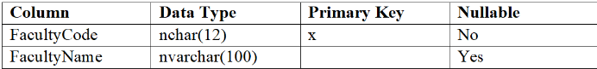
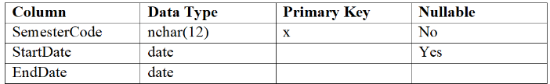
TABLE FACULTY
TABLE SEMESTER

Slide 17
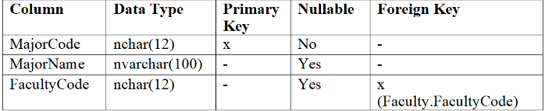
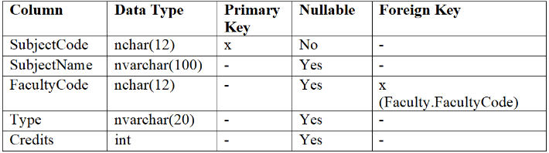
TABLE MAJOR
TABLE SUBJECT

Slide 18
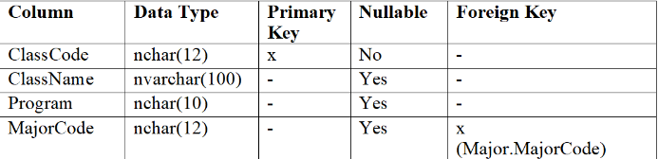
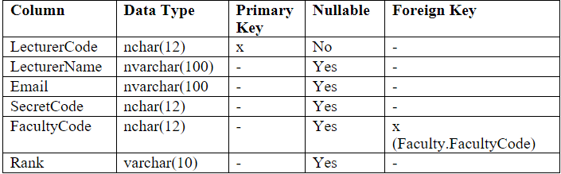
TABLE CLASS
TABLE LECTURER

Slide 19
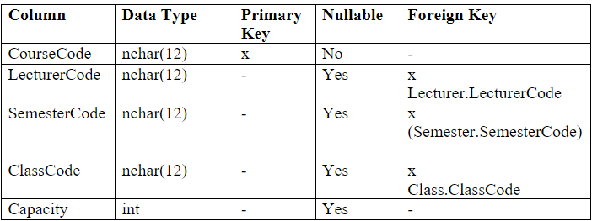
TABLE COURSE

Slide 20
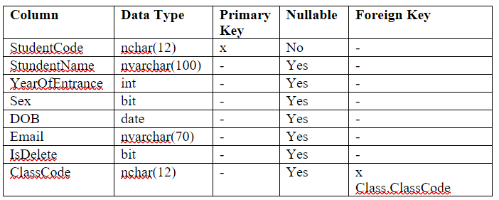
TABLE STUDENT

Slide 21
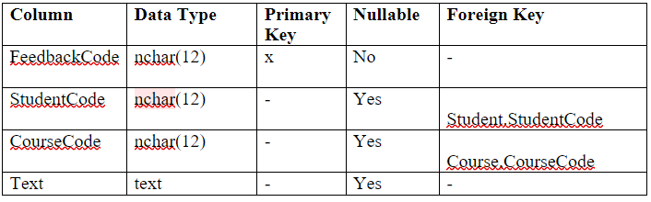
TABLE FEEDBACK

Slide 22
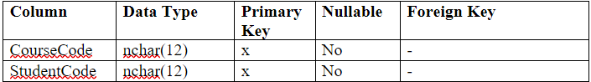
TABLE COURSE REGISTER

Slide 23
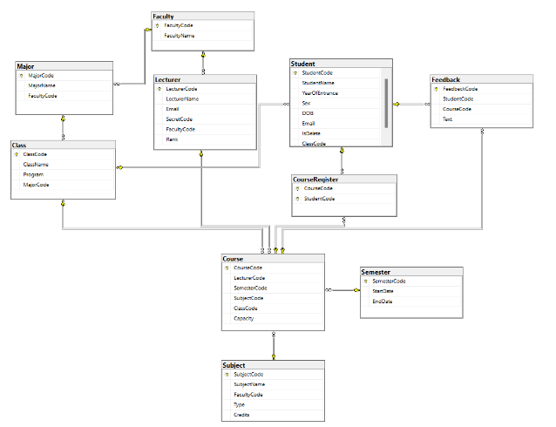
DATABASE DIAGRAM

Slide 24
APPLICATION OF MACHINE LEARNING MODEL

Slide 25
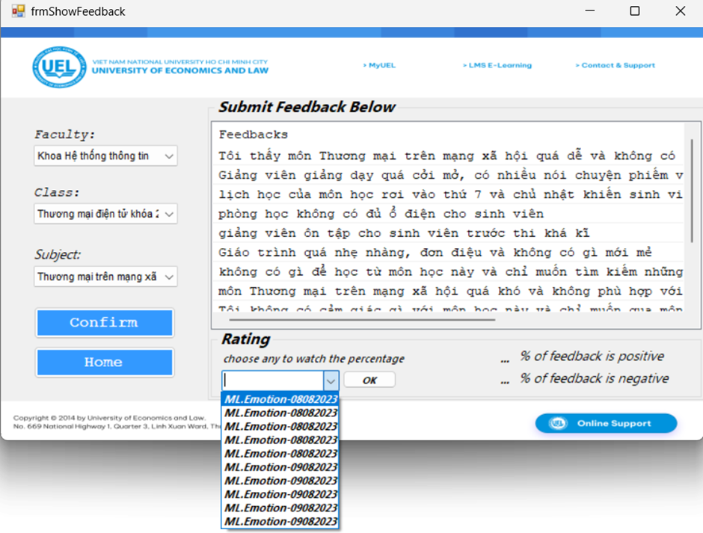
APPLYING MACHINE LEARNING
Once lecturer view this form, they have to choose the model. Then what is our model? How to create or train? I will show you then

Slide 26
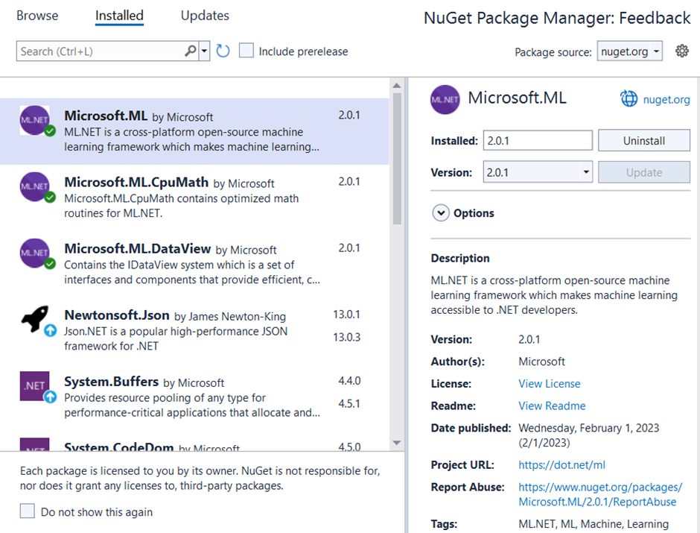
APPLYING MACHINE LEARNING
Download Microsoft's ML.net package on Visual Studio 2022

Slide 27
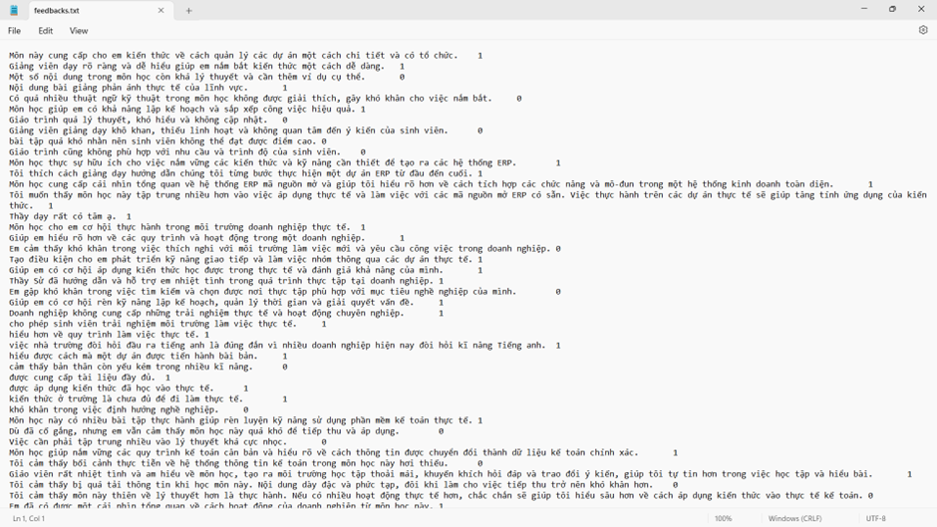
APPLYING MACHINE LEARNING
Label the feedback texts: 0 is negative point and 1 is positive point

Slide 28
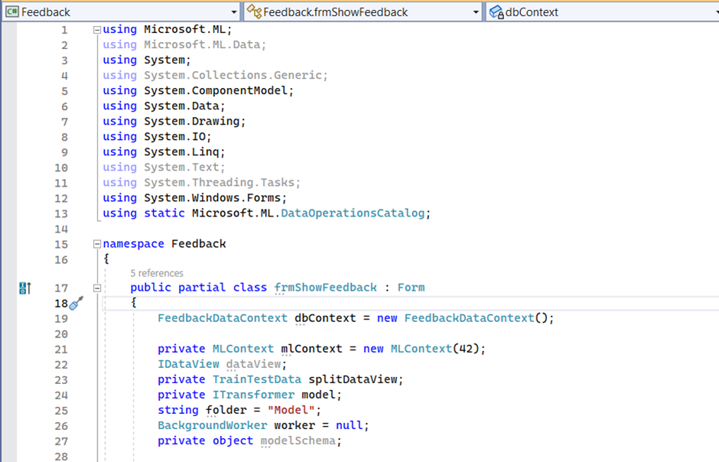
APPLYING MACHINE LEARNING
Using the necessary library, in this project context, we are using ML.NET. It initializes the MLContext, prepares variables for data manipulation, sets up a BackgroundWorker for background tasks, and more. The specific functionality of this form would likely include loading data, training and evaluating a machine learning model, and potentially displaying results to the user.

Slide 29
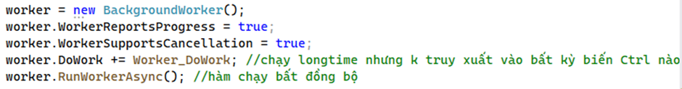
APPLYING MACHINE LEARNING
Then, an event handler named Worker_DoWork is attached to the DoWork event of the BackgroundWorker. This event handler contains the code that will be executed in the background.
Overall, this code sets up a background worker to perform an asynchronous task without freezing the UI, and it specifies an event handler that will execute the task.

Slide 30
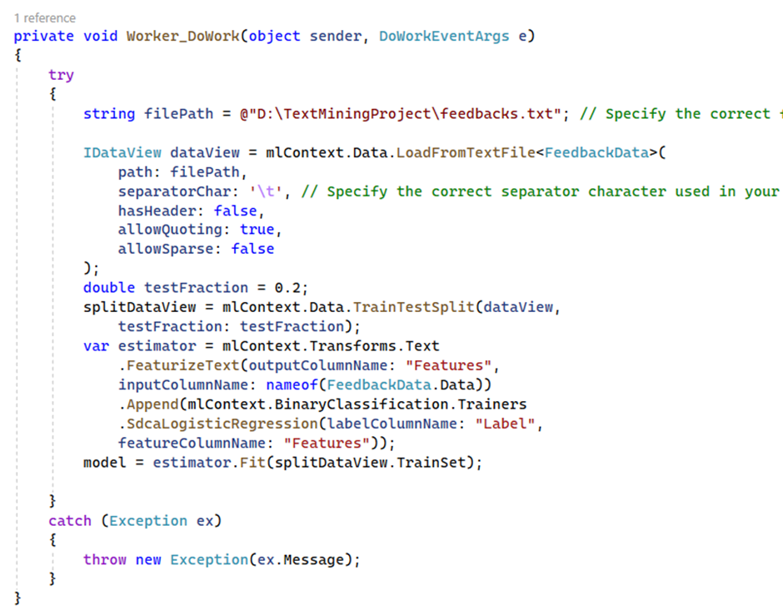
APPLYING MACHINE LEARNING
The purpose of this event handler is to load data from a text file, perform data preprocessing, and train a binary classification model using ML.NET.
Split data to 8:2 with 80% for training and 20% for testing.
Creating an Estimator and Training the Model
An estimator pipeline is constructed using ML.NET's transformation and trainer components.
FeaturizeText transformation is used to convert the text data into numerical features.
SdcaLogisticRegression trainer is used for binary classification. It's a linear classifier optimized for sparse data.
Fit method trains the model using the training set.
This represents what Worker_DoWork executes

Slide 31
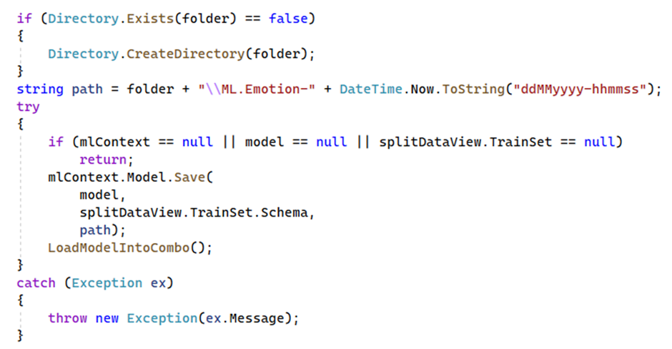
APPLYING MACHINE LEARNING
We are checking whether the directory existed or not, if not, create a new one. Then save the model to combo box as i have shown before

Slide 32
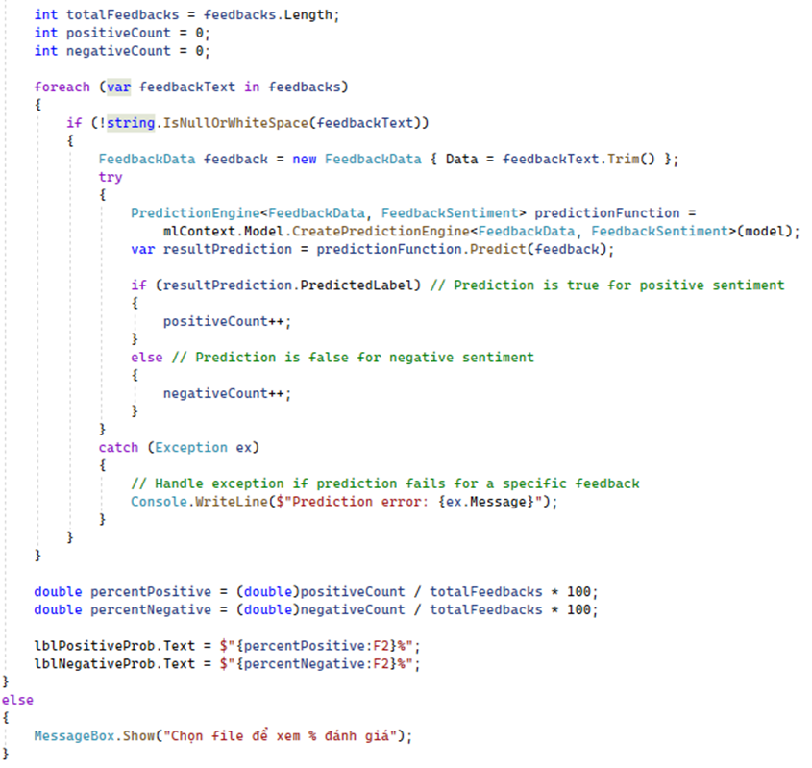
APPLYING MACHINE LEARNING
First, variables are initialized to keep track of the total number of feedbacks, the count of positive sentiments, and the count of negative sentiments.
Then, a FeedbackData object is created with the feedback text to prepare it for prediction. The code attempts to create a prediction engine using the loaded ML.NET model and then predicts the sentiment of the feedback. Based on the prediction result, the counts of positive and negative sentiments are updated.
After iterating through all feedbacks, the code calculates the percentages of positive and negative sentiments. The calculated percentages are then displayed in UI labels (lblPositiveProb and lblNegativeProb).
This represents what how to evaluate %

Slide 33
CONCLUSION AND FUTURE WORKS

Slide 34
CONCLUSIONS
The findings of this study underscore the valuable insights that student feedback can provide. It has become increasingly evident that the quality of education is not solely determined by curriculum design or pedagogical methods; rather, it is an intricate interplay between these elements and the lived experiences of students. By embracing their feedback, institutions open the door to a more responsive and relevant education system.

Slide 35
FUTURE WORKS
While this study has provided a significant stride in understanding student sentiment and its impact on subject enhancement, there lies an uncharted frontier: creating a predictive model that not only analyzes feedback sentiment but also suggests actionable solutions for educators

Slide 36


www.reallygreatsite.com
THANK
YOU!

